Slide 2
KubeEdge
Deep Dive

Slide 3


Zefeng Wang Huawei @kevin-wangzefeng
Cindy Xing Huawei @cindyxing

Slide 4
Our vision and mission
Enable customers to manage resources and run applications natively at cloud and edge
A K8s based infrastructure for IOT/Edge computing.
Manage resources and orchestrate applications in transparent of the location: cloud or edge
K8s APIs and primitive types
Edge is an extension of cloud
Worker nodes can be at cloud or edge
Highly extensible covering diversified network topology, device protocol, storage backend, etc.

Slide 5
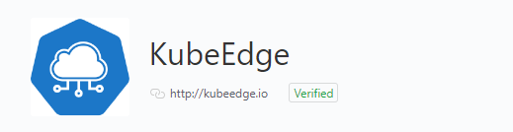
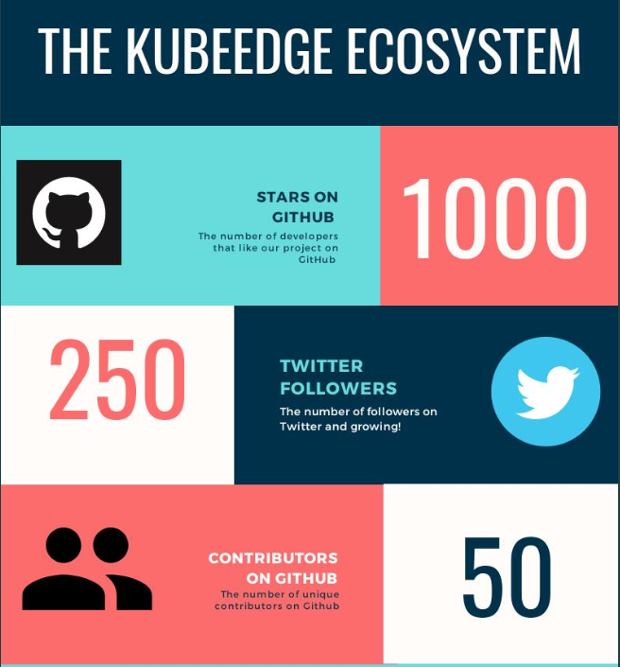
Where Are We Now
KubeEdge targets to edge computing
CNCF Sandbox project
Open-sourced both cloud and edge code
Release 0.1, 0.2 and 0.3
Reference architecture by K8s IOT/Edge WG
K8S IOT/Edge WG

Slide 6
Customer Scenarios and Learnings

Slide 7
Demo
Easy system deployment
Node management
App. Deployment
Simple app development

Slide 8
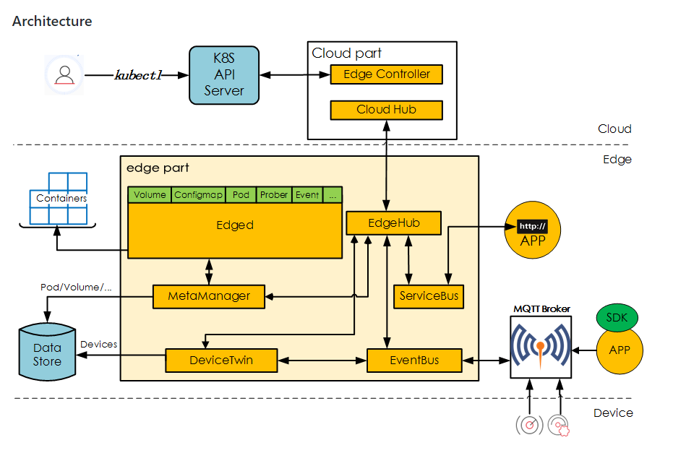
What’s New
Both cloud and edge code are opensourced
Fundamental infrastructure support
Device management and messaging
MQTT, Zigbee, Bluetooth, etc device protocol wrapping support
Edge side autonomy covering network disconnect/reconnect scenario

Slide 9
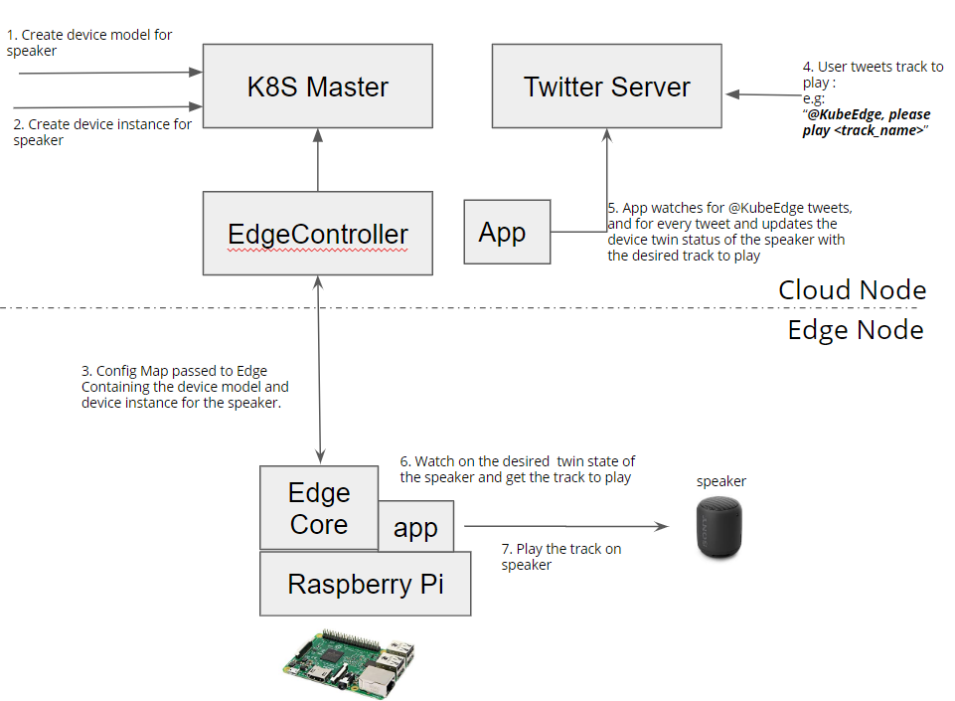
Demo
Scenario: A user tweets a song he wishes to listen along with the #KubeEdge tag. The tweet metadata is pushed to the edge and the song is played on the edge.

Slide 10
Beehive Framework

Slide 11
Autonomy

Slide 12
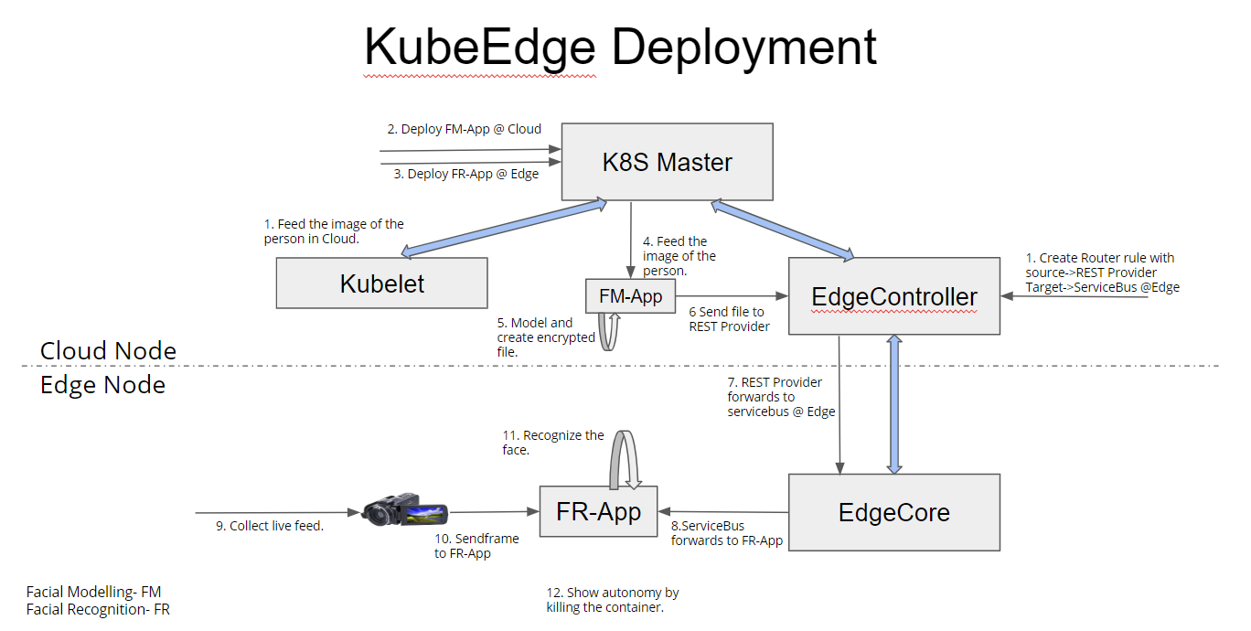
Demo
Scenario: Facial recognition and offline autonomy

